Slide 1
IntelliJ + Scala
Last checked 10/16/2023

Slide 2
WARNING:
Since Scala is a plugin, it can become disconnected during an IntelliJ Update.
If this happens, you will see the Scala files have a “text file” symbol, and you won’t be able to run them.
To fix this, uninstall and then reinstall the plugin.

Slide 3
Installation
IntelliJ has a Scala Plugin
Depending on your original installation, you may already have the SCALA plugin

Slide 4
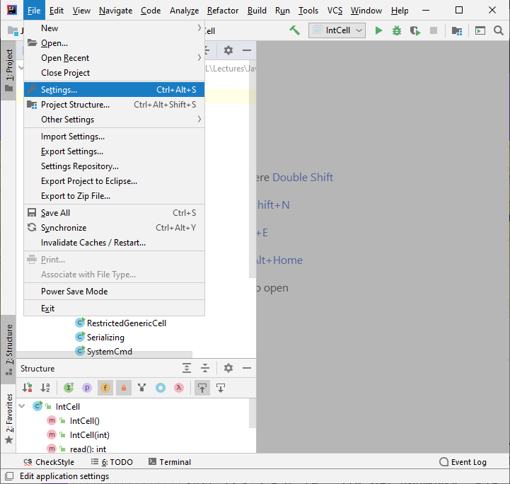
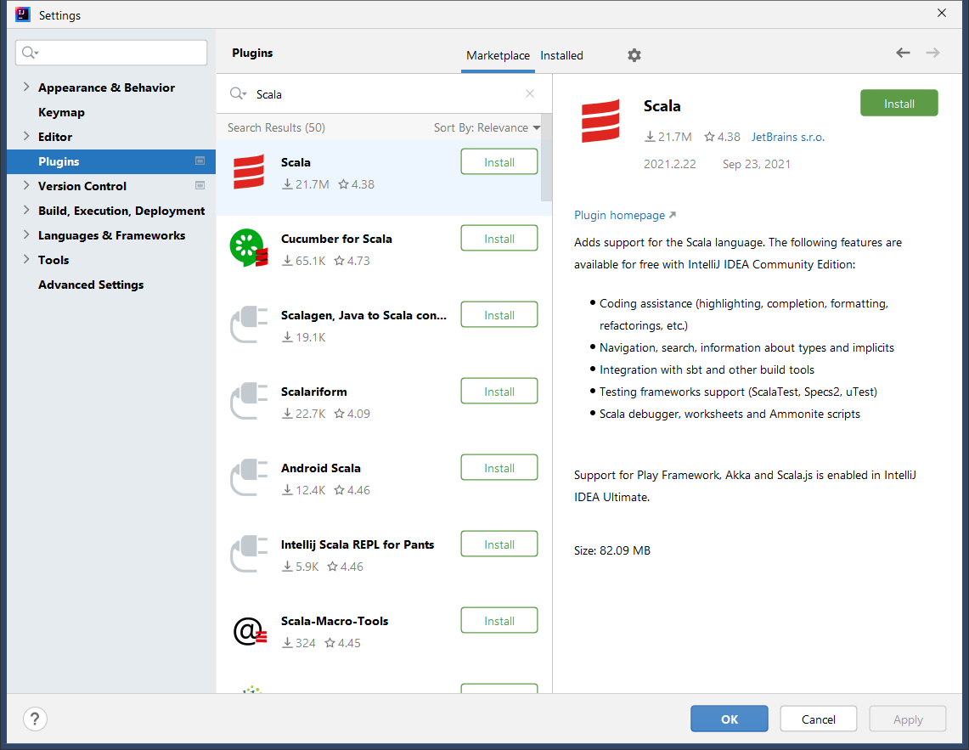
Install Scala
Step 1) install Scala plugin
File→Settings
Plugins → Search for Scala

Slide 5
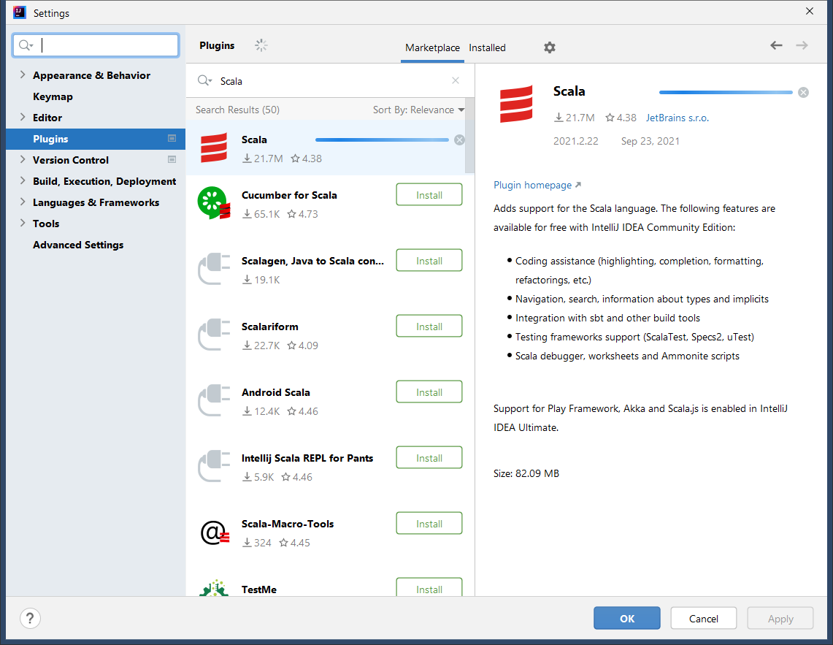
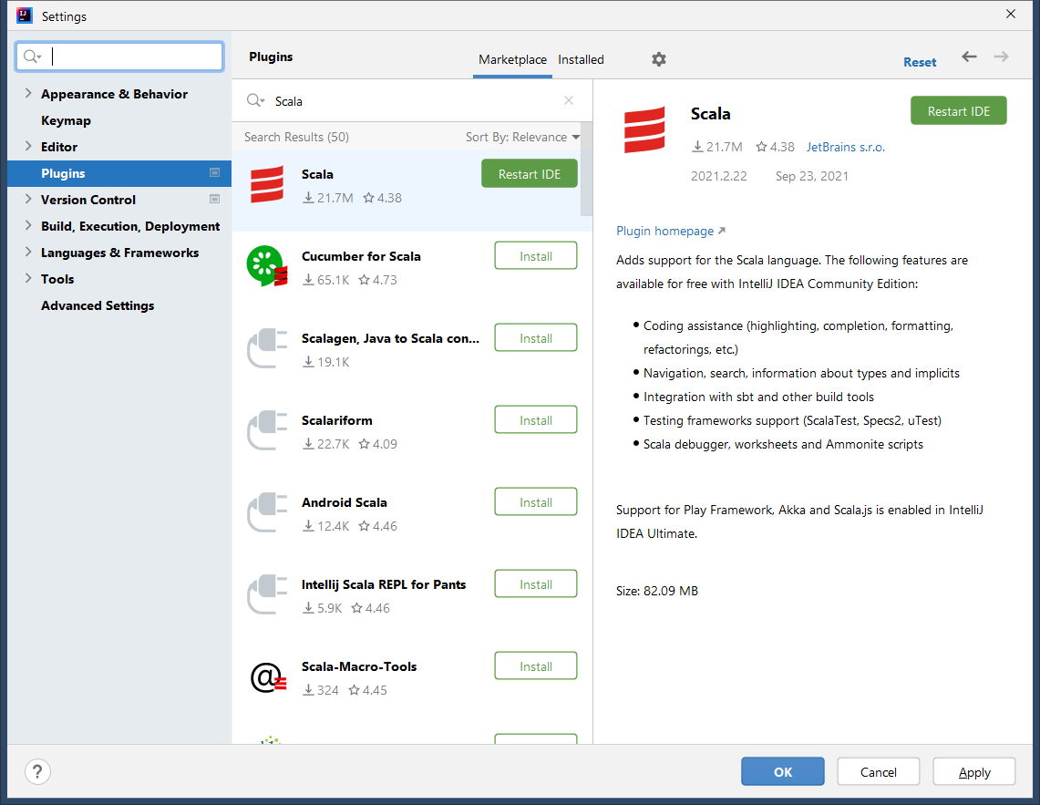
Install Scala
Click the install button
Wait
Then restart IntelliJ

Slide 6
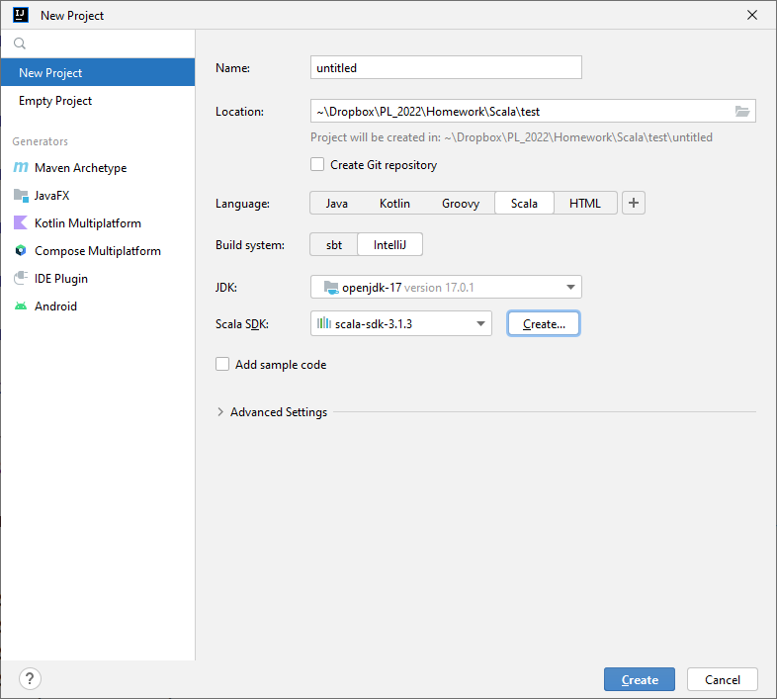
Create a Project
Go to File→New→Project
Give it a name and location
Select Scala
Select System →ItelliJ
Scala “recommends” the SBT, but
This adds quite a bit more to the project that we don’t need just yet
It also has several more steps to setup
Also, IDEA is what we have been using so for consistency, choose the same kind
Select JDK 17
Click on Create next to the SDK (see next page)

Slide 7
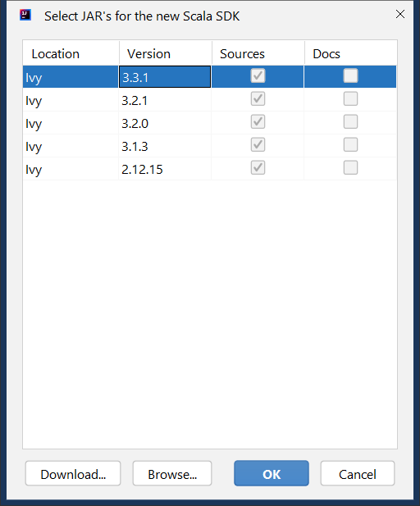
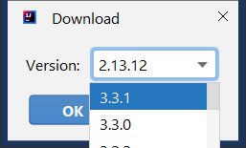
Create Project
These are your available SDKs
In an initial install this is normally empty.
Click Download and choose the most recent 3.3.#
3.3.1 as of this writing

Slide 8
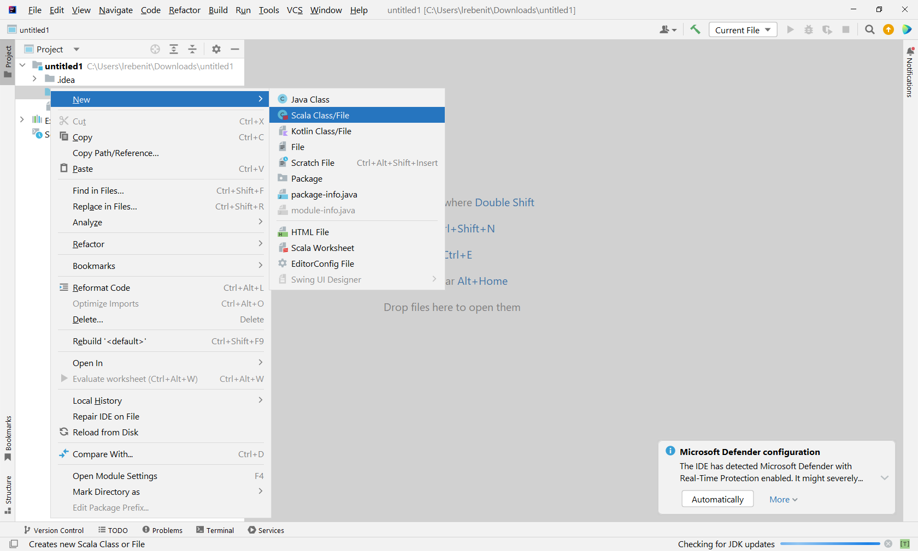
Open your src folder (it should be empty at first), and then right-click. The functions should be VERY similar to IntelliJ, but now we have Scala.

Slide 9
Varieties of Scala files
Scala Class
Inserts basic code for the class
Like Java, the class name MUST match the name of the file
Scala Worksheet
Give line by line output from the scala code
Useful for testing basic code outside the REPL
Does NOT support objects

Slide 10
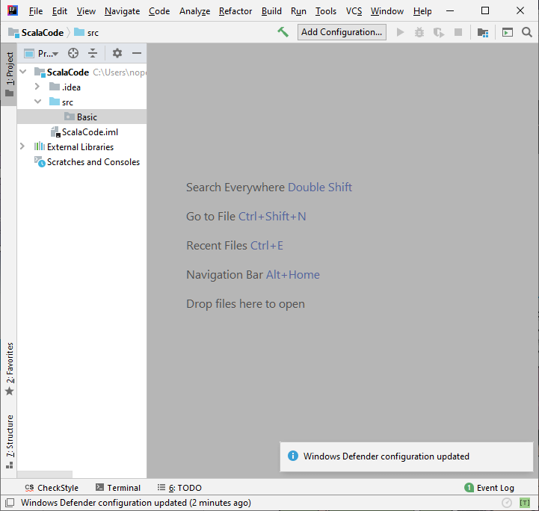
Just to be sure everything works
Right click on src, choose New→Package
Add a Package (I named mine Basic)

Slide 11
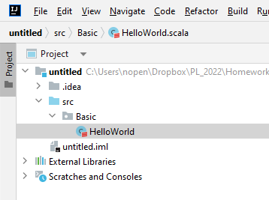
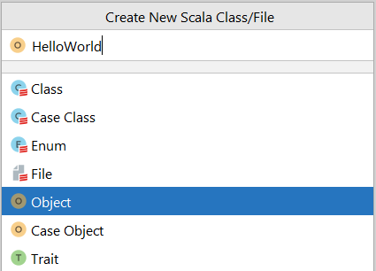
Just to be sure everything works
Right click on the package, choose New→Scala Class\File
In its selector, choose Object
Name it what you want
Reminder: your object/class must match the name
I named mine “HelloWorld.scala”

Slide 12
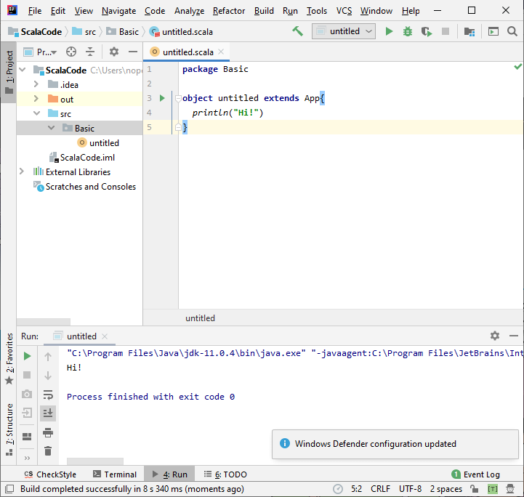
Just to be sure everything works
Add the following code (subbing in your package and file names)
object HelloWorld { def main(arg : Array[String]): Unit = { println("Hi"); } }
It should output “Hi!”

Slide 13
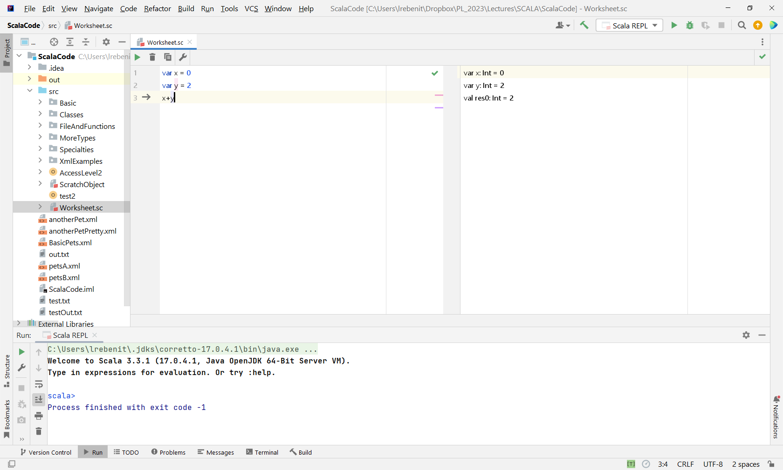
Some Differences in worksheet mode
Evaluate Worksheet rather than run
The second pane show the results line by line

Slide 14
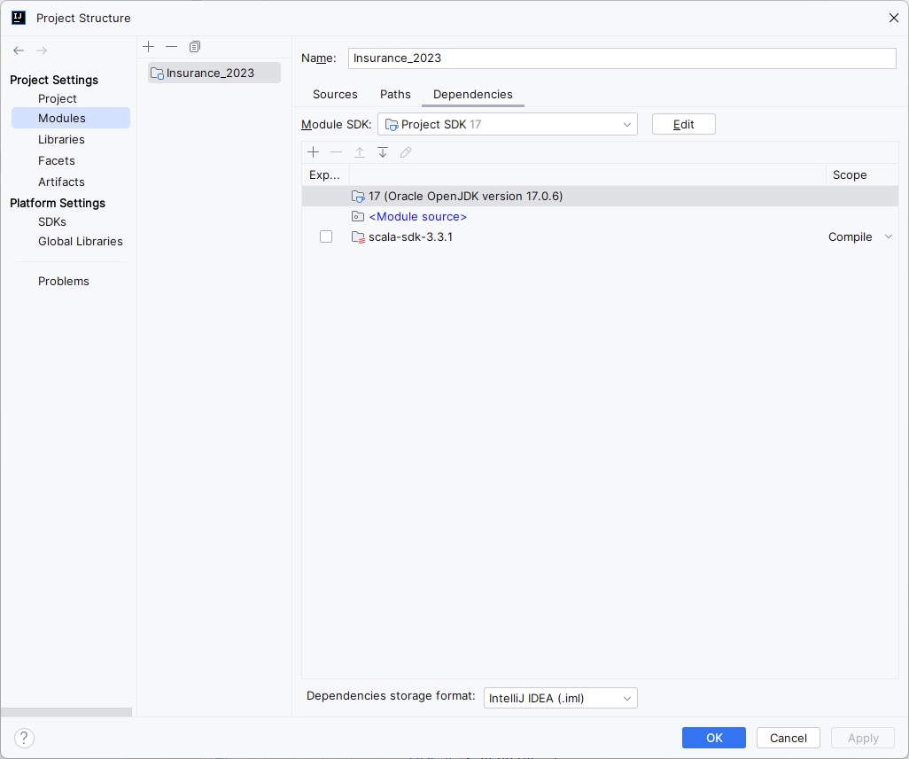
Installing XML (I suggest doing this right away!)
To import xml, choose File → Project Structure
Go to Modules
Select Dependencies

Slide 15
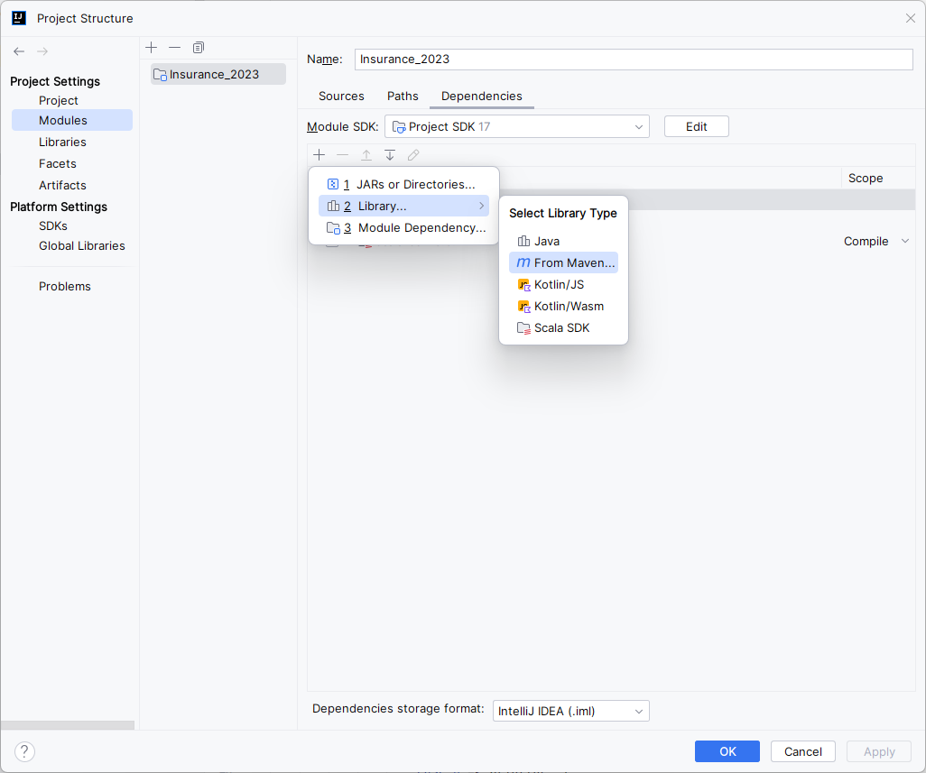
Installing XML
We need to install a new library.
Click on the + sign, and then Libraries, then From Maven
If you already have downloaded a library, a different window will pop up on selecting Libraries. Choose “New Library” then “From Maven” in that case.

Slide 16
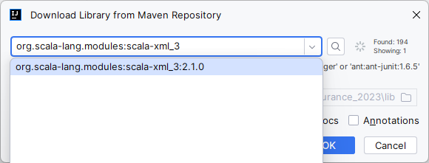
Installing XML
Choose where you want to save the library (REMEMBER THIS), and then type in “org.scala-lang.modules” and search
I do NOT advise putting it inside your project, which is where it defaults.
I usually put it with the other scala modules (path found under global libraries)
Then search this list for org.scala-lang.modules:scala-xml
For some reason the search likes to fail with longer names on the first search. Thus, the round about method to search
You should see a list of 3.X options. Select the most recent (3:2.1.0 as of this writing)

Slide 17
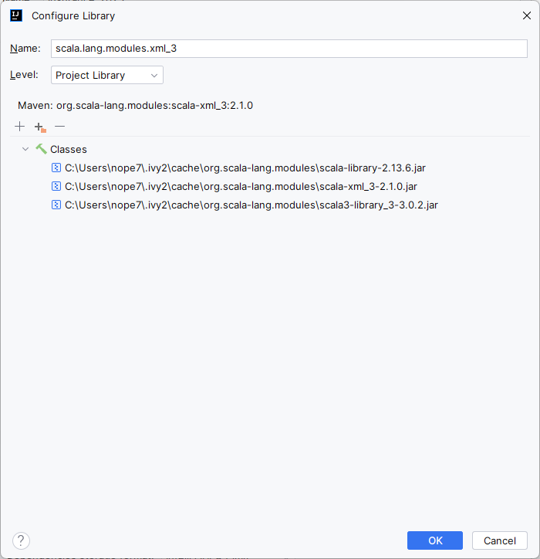
Installing XML
Name it what you want, and click ok

Slide 18
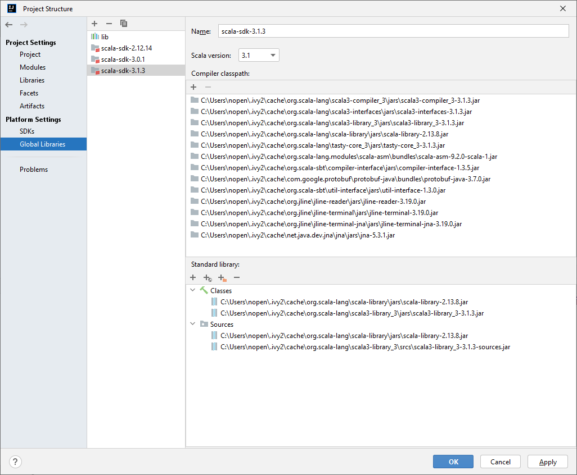
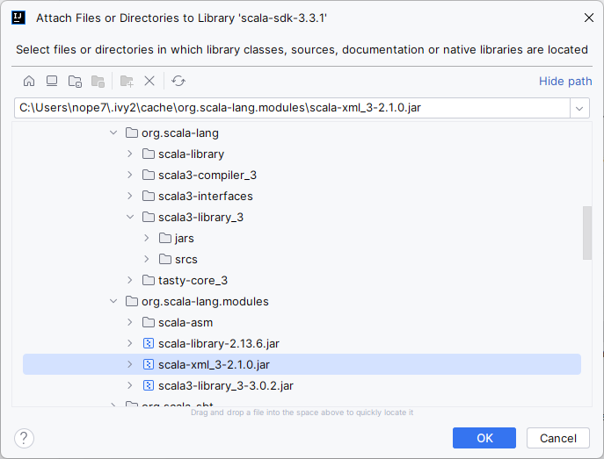
Now let’s make that permanent for ALL future projects
Switch to Global Libraries, select your version of Scala, and then the lower + button
Find where you downloaded the library, and add it
When done, go ahead and remove the xml dependency from the Module.

Slide 19
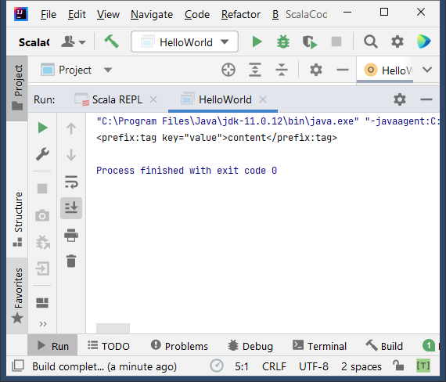
To check if it is working….
Add this
If should output:
package Basic import scala.xml.{Elem, Null, Text, TopScope, UnprefixedAttribute} object HelloWorld { def main(arg : Array[String]): Unit = { val c = Elem("prefix", "tag", new UnprefixedAttribute("key", "value", Null), TopScope, true, Text("content")); println(c); } }
Don’t panic on the crazy Elem line. I’ll be posting a helper class for you to make that much easier.

Slide 20
Parallel (will be needed later)
Now repeat those step and download the parallel library too.
As of this writing: org.scala-lang.modules:scala-parallel-collections_2.13:1.0.4
OR, download directly from the web as shown next
This is good to know to confirm versioning

Slide 21
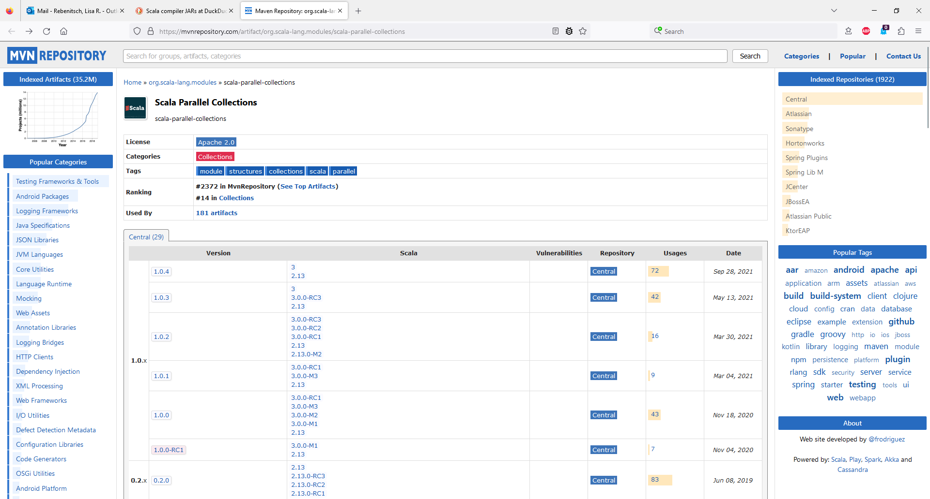
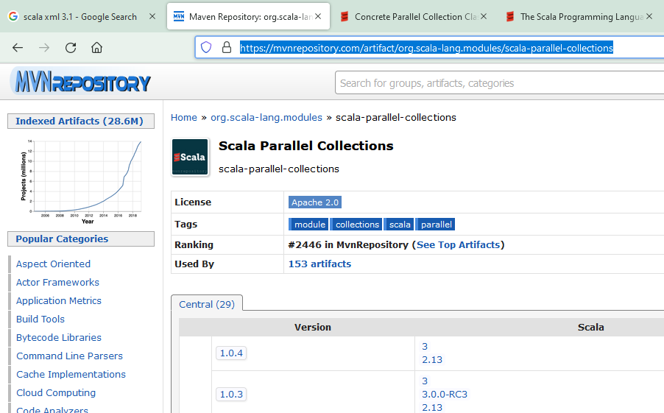
Option 2 for extra dependencies (will be needed later)
You
You can download the libraries directly from maven. The start of the main scala libraries is here: https://mvnrepository.com/artifact/org.scala-lang.modules
In this case, we want the parallel library (libraries are ordered in popularity): https://mvnrepository.com/artifact/org.scala-lang.modules/scala-parallel-collections
Click on the most recent version

Slide 22
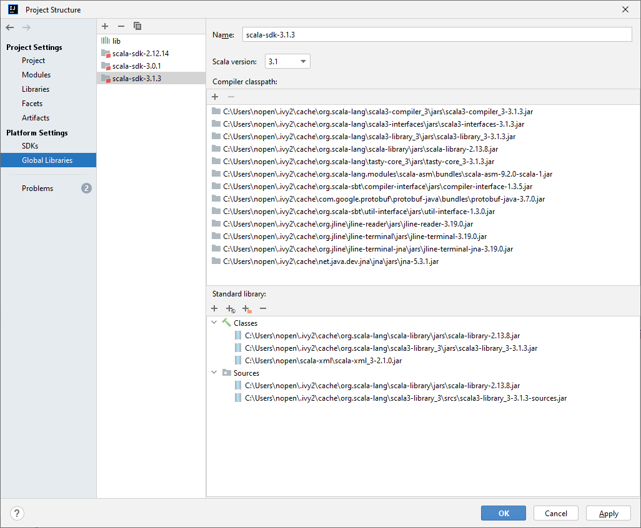
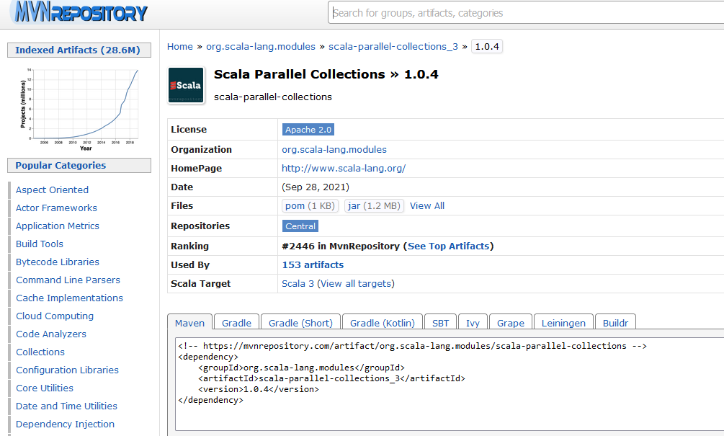
Completing the install
Click on the “jar” and save where you want it
Back in IntelliJ, open File → Project Structure→ Global Libraries → + Sign

Slide 23
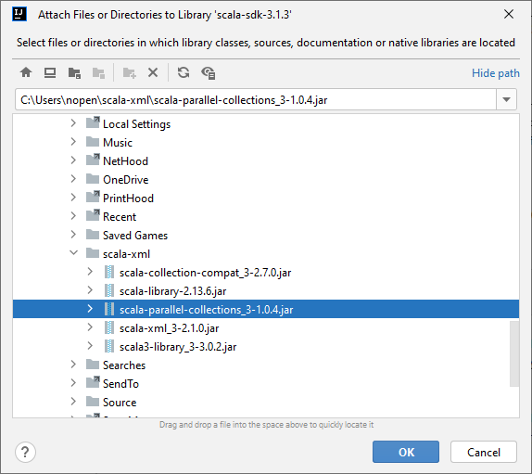
Completing the install
Find were you saved the library, and click OK, and then OK again
That will allow access from now on. To see if it is working, copy in the code below and run. It should output: ParVector(0, 2, 4, 6, 8)
import scala.collection.parallel.immutable._ object HelloWorld { def main(arg : Array[String]): Unit = { val pv = ParVector.tabulate(10)(x => x) val pv2 = pv.filter (_ % 2 == 0) print(pv2) } }

